Slide 1

Quantifying North American methane emissions using satellite observations of methane columns
Daniel J. Jacob
with
Alex Turner, Bram Maasakkers, Melissa Sulprizio, Kevin Wecht (Harvard)
Anthony Bloom, Kevin Bowman (JPL)
Tom Wirth, Melissa Weitz, Leif Hockstad, Bill Irving (EPA)
Robert Parker, Hartmut Boesch (U. Leicester)

Slide 2
Importance of methane for climate policy
Present-day emission-based forcing of methane is 0.95 W m⁻² (IPCC AR5), compared to 1.8 W m⁻² for CO₂
Climate impact of methane is comparable to CO₂ over 20-year horizon
Methane controls provide a lever for mitigating near-term climate change
Controlling methane has additional benefit for air quality
Global sources,
EDGAR4.2+LPJ
(Tg a⁻¹)
Fires
20
Livestock
110
Problem: large diversity
of poorly constrained sources
Wetlands
160
Landfills
60
Gas
70
Other
30
Rice
40
Coal
50

Slide 3
High-resolution satellite-based inverse analysis system
to quantify methane emissions in North America
Satellite data
SCIAMACHY
2002-2005
TROPOMI
2016-
GOSAT
2007-
Geostationary
OSSE
Bottom-up (prior)
Suborbital data
EDGAR v4.2 + LPJ
EPA
New wetlands
GEOS-Chem CTM and adjoint
1/2ºx2/3º over N. America
nested in 4ºx5º global
Aircraft campaigns
Surface networks
Bayesian
inversion
Validation
Verification
Optimized emissions at up to 50 km resolution
CMS publications so far:
Wecht et al. [JGR 2014]: inversion of SCIAMACHY data for 2004
Wecht et al. [ACP 2014]; inversion of CalNex data + OSSEs for TROPOMI, Geo

Slide 4
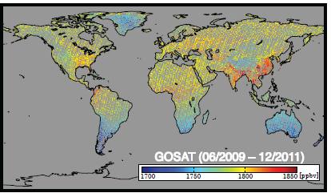
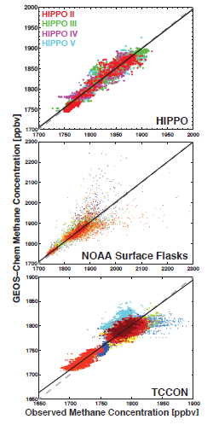
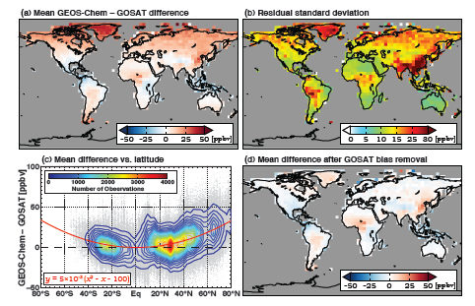
Indirect validation of GOSAT with suborbital data using GEOS-Chem prior as intercomparison platform
No GEOS-Chem background bias
vs. global suborbital data
Correction of GOSAT high-latitude bias
R² = 0.94
slope = 0.97
GOSAT
GEOS-Chem
minus
GOSAT
R² = 0.62
slope = 0.98
GEOS-Chem
minus
corrected
GOSAT
R² = 0.81
Slope = 0.92
mean single-retrieval
GOSAT precision 13 ppb
Turner et al. [in prep]

Slide 5
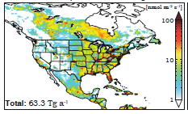
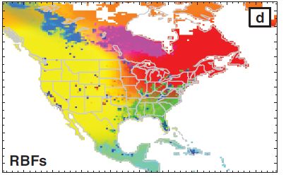
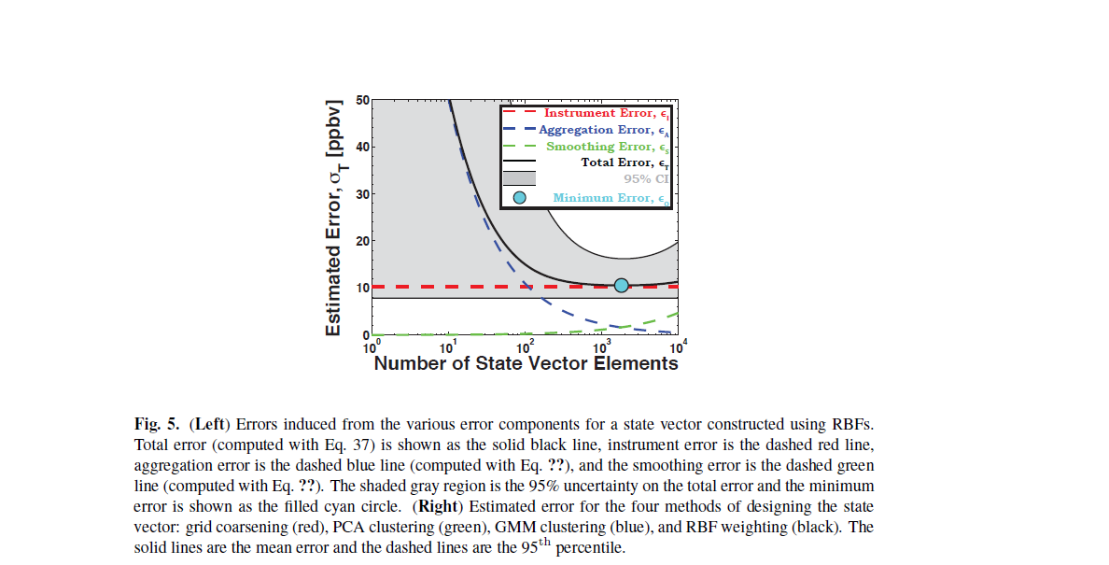
Balancing aggregation and smoothing inversion errors in selection of emission state vector dimension
Native-resolution 1/2ºx2/3º
emission state vector x (n = 7096)
Reduced-resolution
state vector x_{ω} (here n = 8)
Aggregation matrix Γ_{ω}
x_{ω} =Γ_{ω}x
observation
aggregation
smoothing
total
Choose n = 369 for negligible aggregation error; allows analytical inversion with full error characterization
Posterior error
depends on choice
of state vector
dimension
Mean error s.d., ppb
10 100 1,000 10,000
Number of state vector elements
Posterior error covariance matrix:
Aggregation Smoothing Observation
Turner and Jacob, in prep.

Slide 6
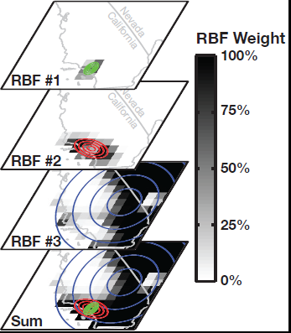
Using radial basis functions (RBFs) with Gaussian mixing model as state vector
Dominant RBFs for emissions
In a Los Angeles 1/2ºx2/3º gridsquare
State vector of 367 Gaussian 14-D pdfs optimally selected from similarity criteria in native-resolution state vector
Each 1/2ºx2/3º grid square is unique linear combination of these pdfs
This enables native resolution (~50x50 km²) for major sources and much coarser resolution where not needed
Turner and Jacob, in prep.

Slide 7
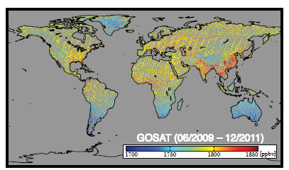
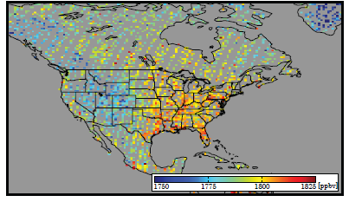
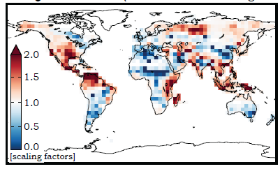
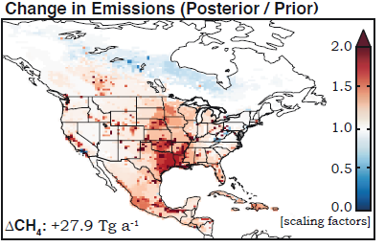
Global inversion of GOSAT data feeds boundary conditions for North American inversion
GOSAT observations, 2009-2011
Dynamic
boundary
conditions
Adjoint-based inversion
at 4ºx5º resolution
Analytical inversion
with 369 Gaussians
correction factors to EDGAR v4.2 + LPJ prior
Turner et al., in prep.

Slide 8
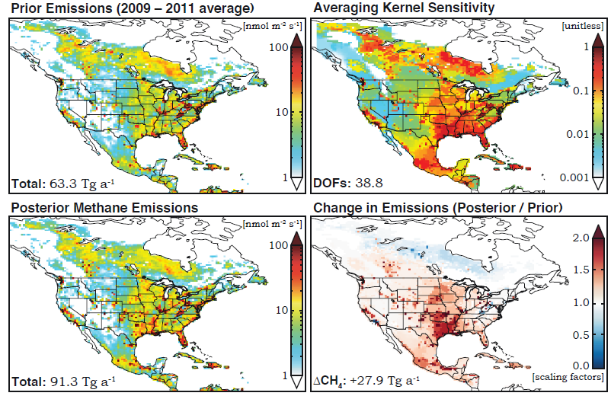
Posterior distribution of North American emissions
Averaging kernel matrix indicates 39 degrees of freedom for signal (DOFS)
Turner et al., in prep.

Slide 9
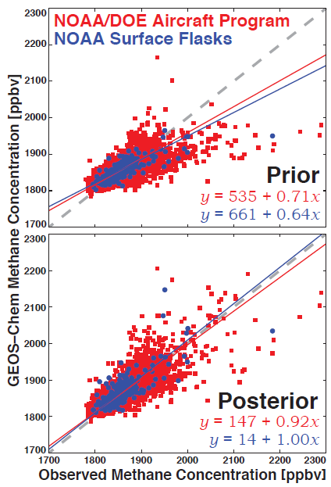
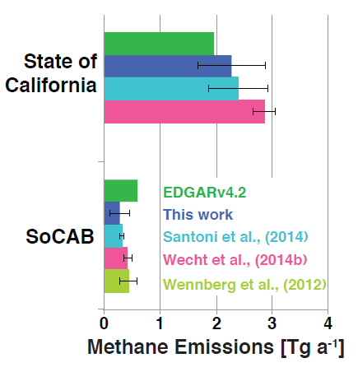
Evaluation of posterior emissions with independent data sets In contiguous US (CONUS)
GEOS-Chem simulation
with posterior vs. prior emissions
Comparison of California results
to previous inversions of CalNex data
(Los Angeles)
Turner et al., in prep.

Slide 10
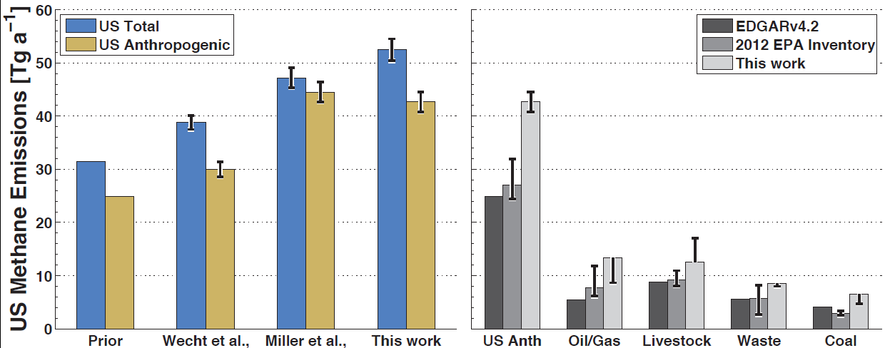
Methane emissions in CONUS: comparison to previous studies, attribution to source types
Ranges from
prior error
assumptions
Anthropogenic emissions are 50% higher than EPA national inventory
Attribution of underestimate to oil/gas or livestock is sensitive to assumptions on prior errors
Improve source attribution in the future by
  Better observing system (more GOSAT years, TROPOMI, SEAC³RS,…)
  Better bottom-up inventory (gridded EPA inventory, wetlands)
Turner et al., in prep.

Slide 11
Construction of a 0.1ºx0.1º monthly gridded version of the EPA national bottom-up inventory
Use monthly state/county/GGRP/algorithm info from EPA, further distribute with data from other sources (USDA, EIA, DrillingInfo,…)
Done as collaboration between Harvard and EPA Climate Change Division
Provide improved prior for inversions and feedback to guide improvement in bottom-up inventory
Livestock
(enteric)
EDGAR, 2010
Livestock
(enteric)
EPA, 2012
Livestock
(enteric)
EPA-EDGAR
EPA livestock
enteric emissions.
2012
Maasakkers et al., in progress

Slide 12
Construction of a 0.1ºx0.1º monthly gridded version of the EPA national bottom-up inventory
Use monthly state/county/GGRP/algorithm info from EPA, further distribute with data from other sources (USDA, EIA, DrillingInfo,…)
Done as collaboration between Harvard and EPA Climate Change Division
Provide improved prior for inversions and feedback to guide improvement in bottom-up inventory
Livestock
(manure)
EDGAR, 2010
Livestock
(manure)
EPA, 2012
Livestock
(manure)
EPA-EDGAR
Maasakkers et al., in progress

Slide 13
Construction of a 0.1ºx0.1º monthly gridded version of the EPA national bottom-up inventory
Use monthly state/county/GGRP/algorithm info from EPA, further distribute with data from other sources (USDA, EIA, DrillingInfo,…)
Done as collaboration between Harvard and EPA Climate Change Division
Provide improved prior for inversions and feedback to guide improvement in bottom-up inventory
Rice: EPA EDGAR Difference
Maasakkers et al., in progress

Slide 14
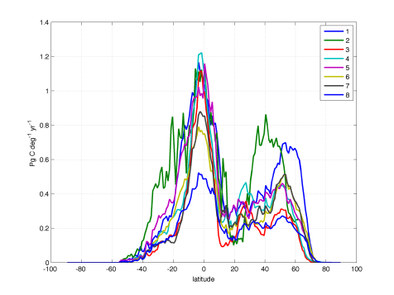
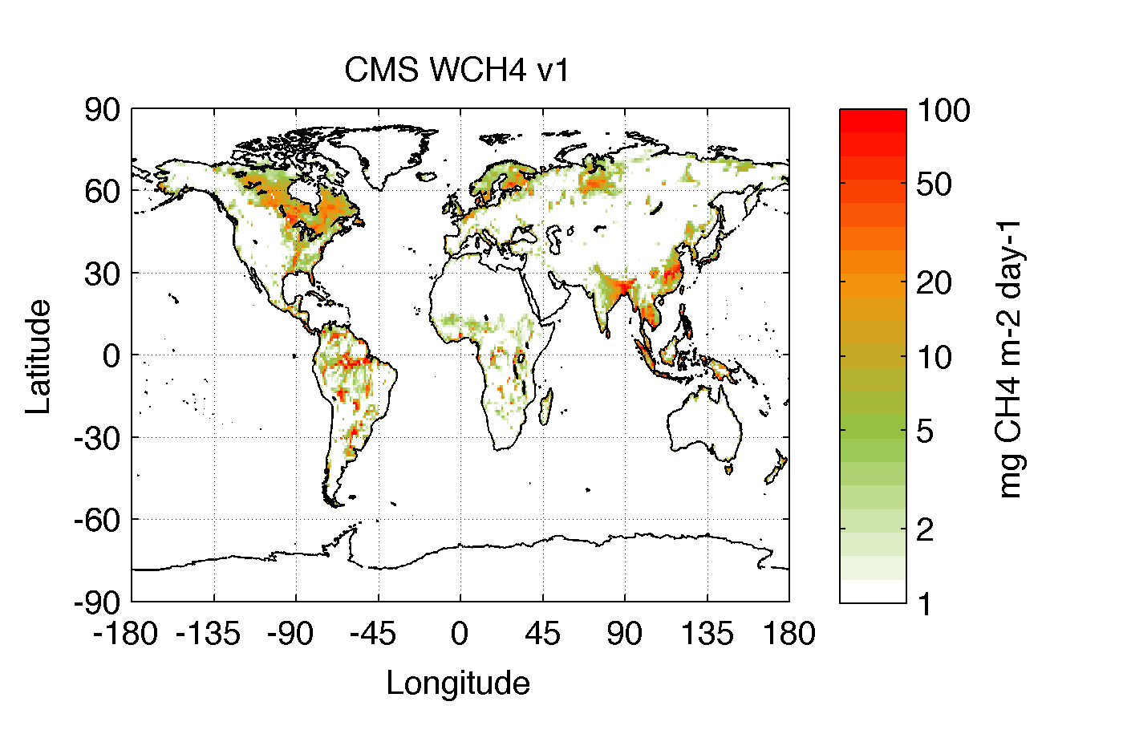
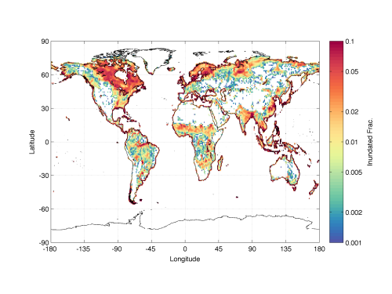
Construction of a global and N American wetland and rice bottom-up emissions inventory
Wetland & Rice CH4 emissions model
Terrestrial biosphere models
MsTMIP model ensemble
Huntzinger et al., 2013
Bottom up CMS wetland and rice CH₄ emission inventory: global monthly 1x1 degree CH₄ emission climatology.
Wetland Extent
MEaSUREs and GIEMS multi-satellite datasets
wetlands.jpl.nasa.gov, Shroeder et al., 2014, Prigent et al., 2007
Bloom et al., in progress

